Slide 1


Charge Injection System (CIS) Update
Katie Hughes, Dawit Belayneh
The University of Chicago
May 9, 2022

Slide 2
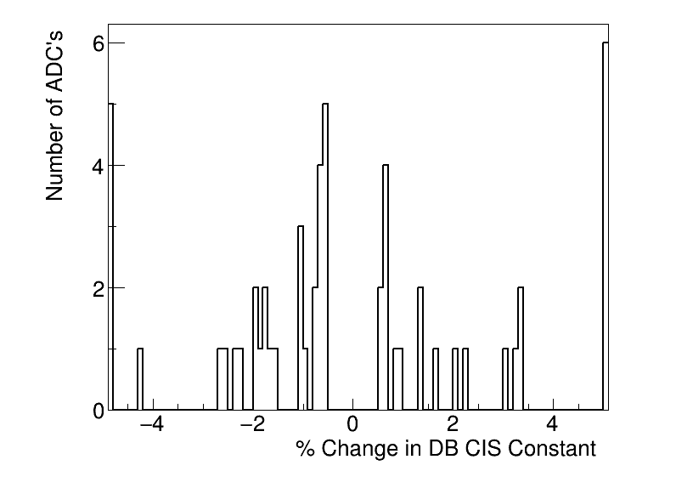
Summary
CIS runs from Apr. 1 - Mar. 1
Will update database after this meeting
55 channels in update
20 Good
9 >5% change
13 Masked
22 Affected
Notes:
Channels in update is much larger than usual (~125)

Slide 3
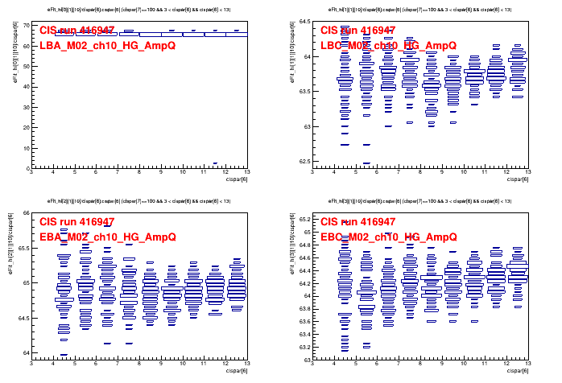
Run Selection
Many groups of CIS runs taken in quick succession to test for missing pulses
If there are multiple runs per day, I only take one.
LBA LG has bad Amp/Q in 416936, 416938, 416943, 416965, 416973, 417549
LBA HG has bad Amp/Q in 416935, 416943, 416947, 416960, 416970
Run list used: 416626, 416941, 417164, 417535, 417882, 418169, 418412, 418778, 418994, 419504

Slide 4
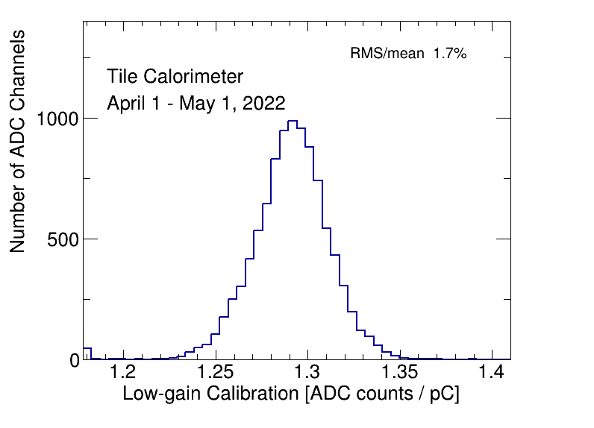
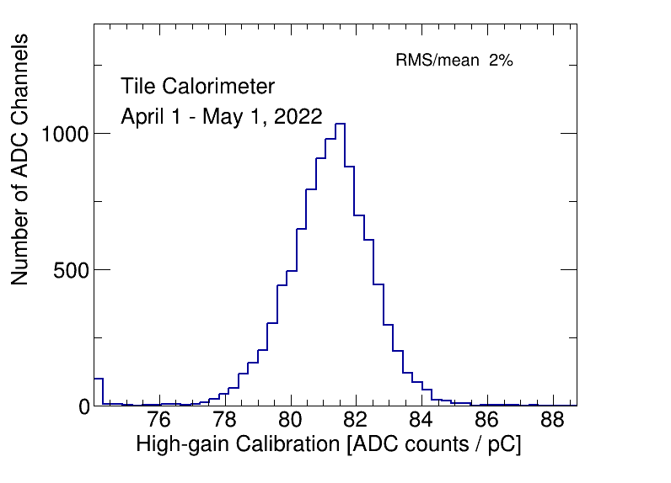
CIS constant distributions

Slide 5
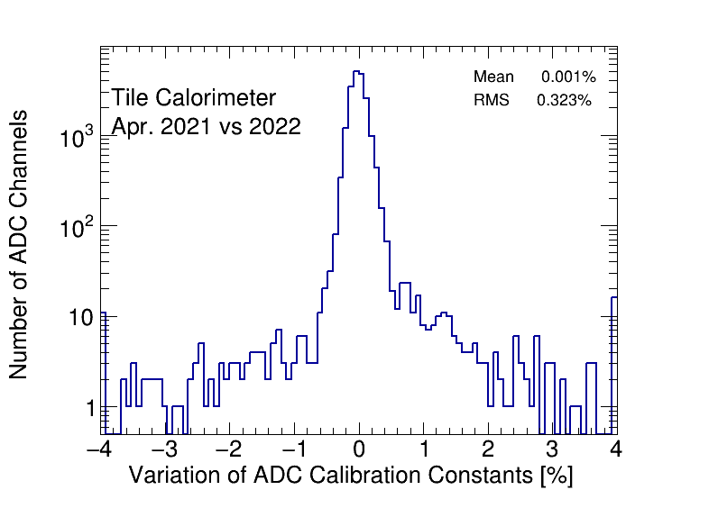
CIS constant stability

Slide 6
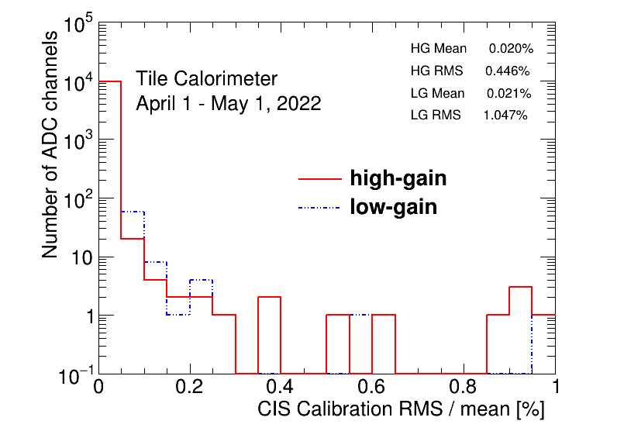
CIS constant RMS/mean

Slide 7
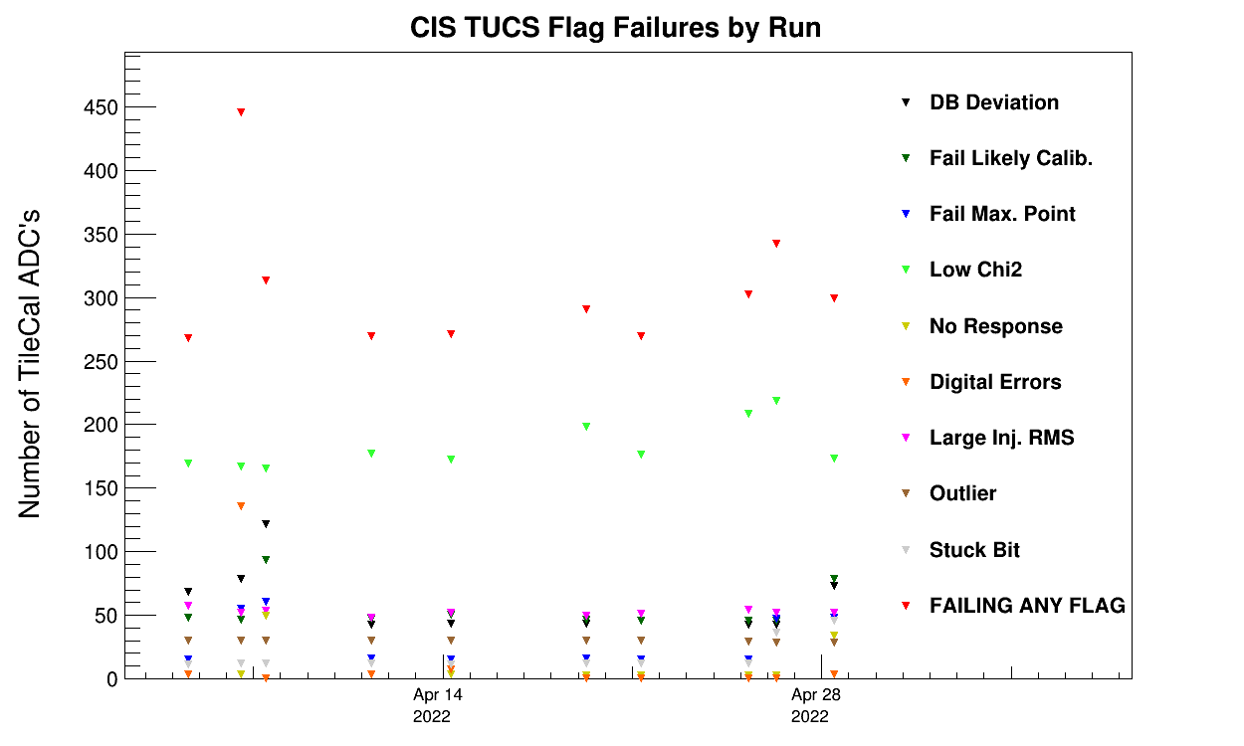
CIS TUCS Quality Flags

Slide 8
Interesting channel behaviour

Slide 9
High Deviation Channels
EBC_m18_c04_lowgain 0.63 0.96 51.35%
LBA_m02_c06_highgain 1.21 75.83 6166.85%
LBA_m02_c06_lowgain 74.87 1.23 -98.36%
LBC_m17_c38_highgain 79.33 83.75 5.57%
LBC_m19_c22_lowgain 1.24 0.78 -37.41%
LBC_m23_c20_lowgain 1.61 1.82 12.61%
LBC_m41_c25_highgain 44.49 47.13 5.92%
LBC_m47_c35_lowgain 0.97 1.11 14.14%
LBC_m57_c06_highgain 80.52 70.07 -12.98%
I accidentally mixed up the gains of these channels when doing manual recalibrations last update. They will be fixed when I push this update.

Slide 10
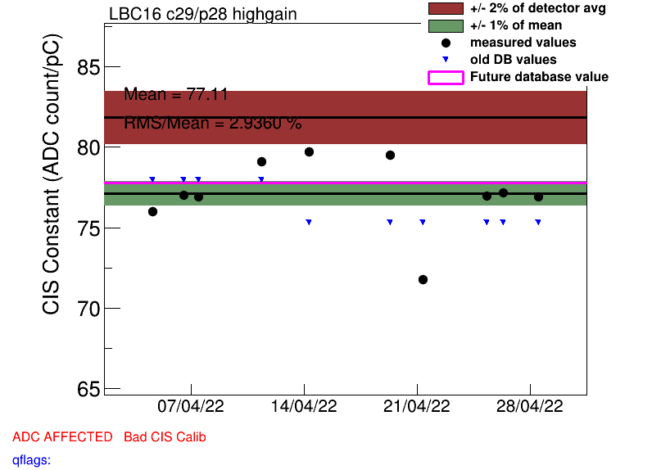
Some High Scatter Channels
EBA_m42_c30_highgain
EBC_m13_c03_lowgain
EBC_m20_c10_lowgain
EBC_m30_c11
EBC_m56_c41_lowgain
LBA_m03_c17_lowgain
LBA_m37_c21_highgain
LBA_m45_c06_highgain
LBA_m51_c12_highgain
LBA_m64_c29_highgain
LBC_m13_c15
LBC_m16_c29_highgain
LBC_m23_c20_lowgain
LBC_m28_c04_lowgain
LBC_m43_c24_highgain
LBC_m52_c18_highgaind

Slide 11
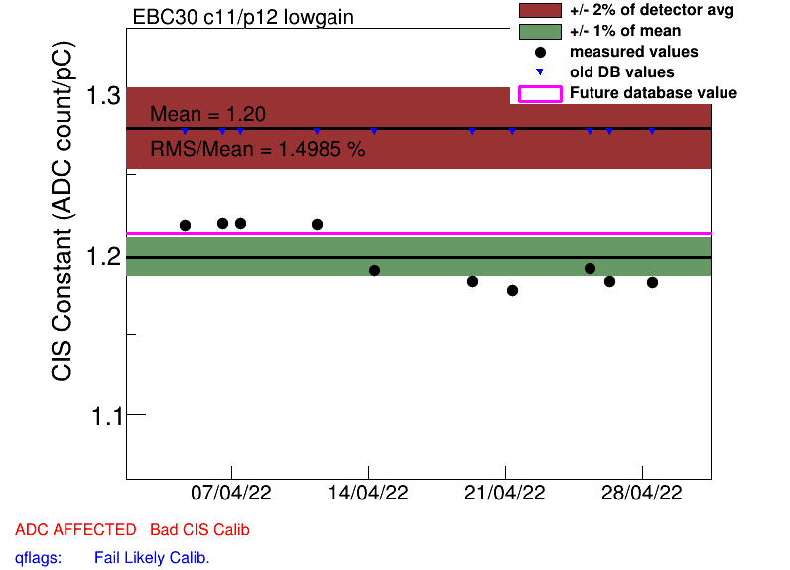
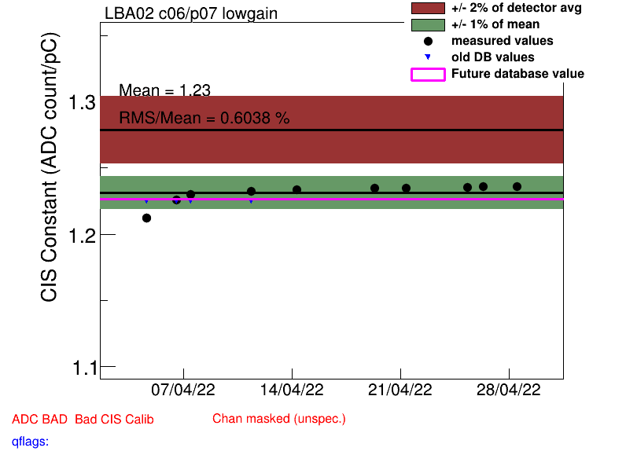
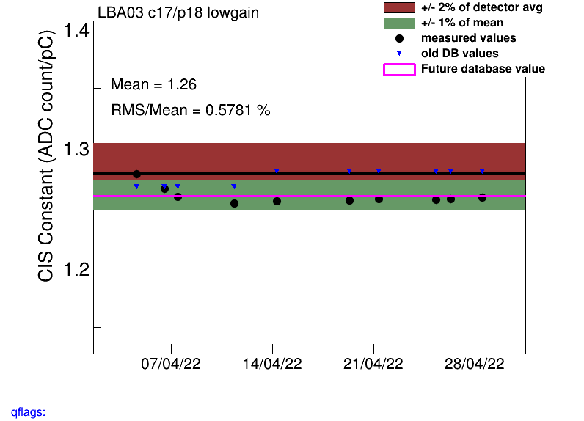
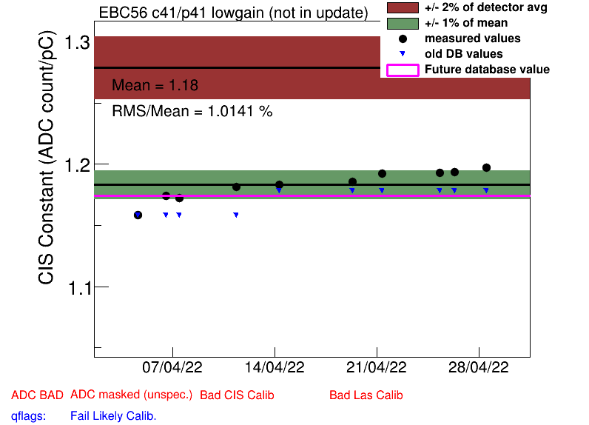
Drifting Channels
EBC_m30_c11
EBC_m56_c41_lowgain
LBA_m02_c06
LBA_m03_c17_lowgain

Slide 12
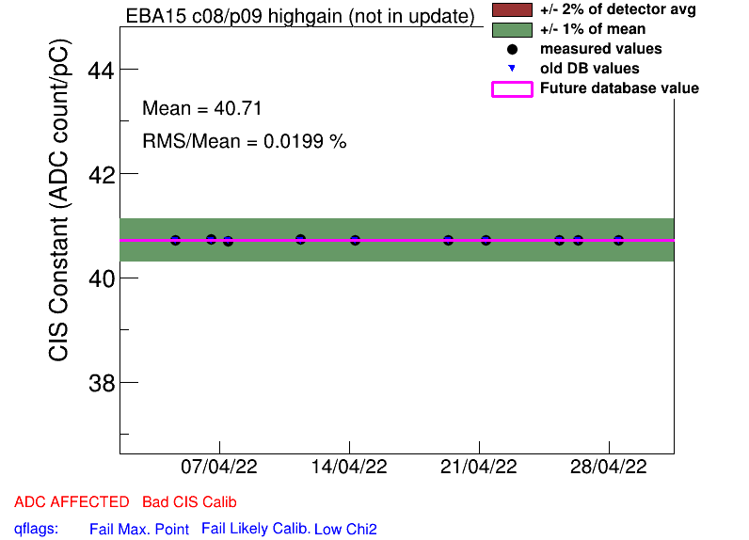
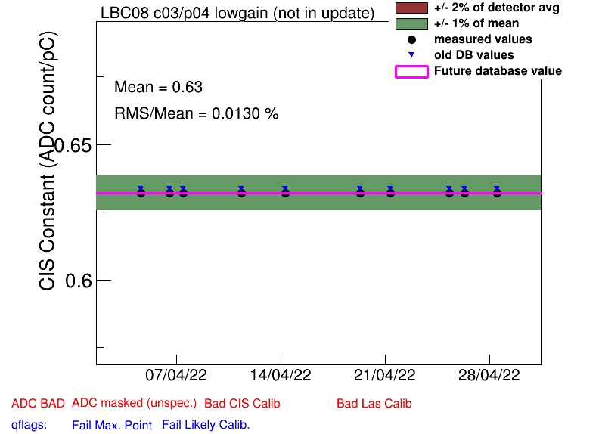
Half Gain Channels
EBA_m15_c08_highgain
EBA_m16_c00_highgain
EBA_m36_c15_highgain
EBA_m48_c31_lowgain
EBA_m64_c03_highgain
EBC_m09_c40_highgain
EBC_m21_c36_lowgain
LBA_m37_c19_highgain
LBC_m08_c03_lowgain
(all same as last CIS update)

Slide 13
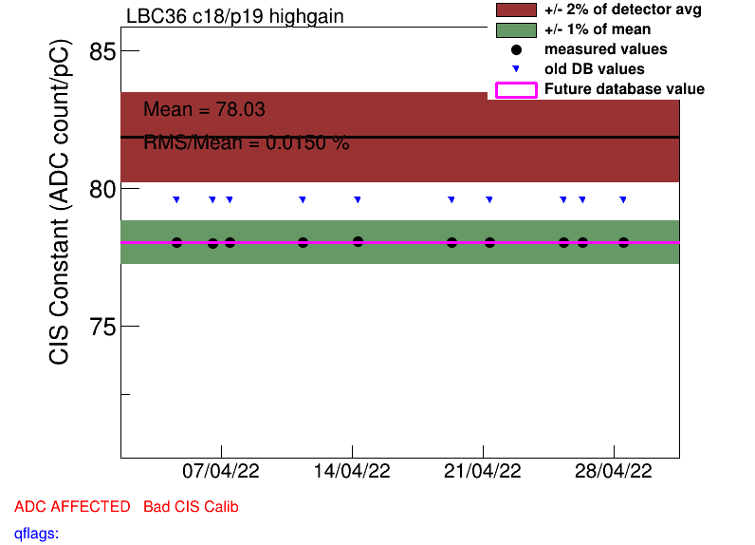
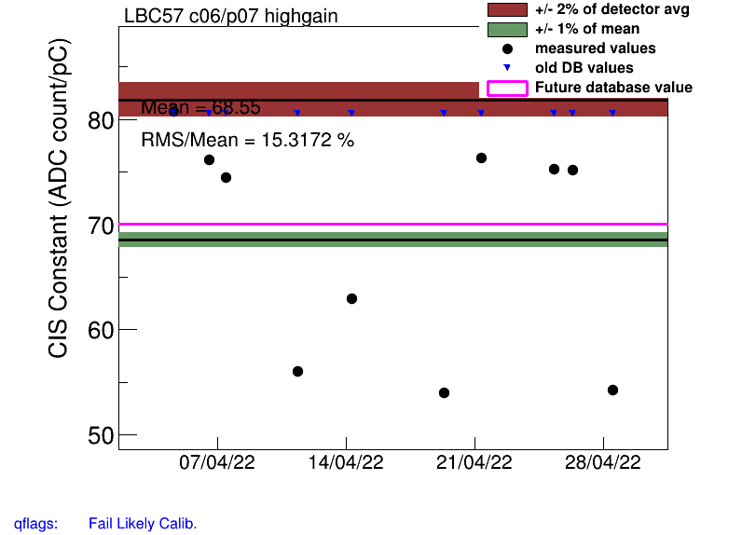
COOL Flag Updates
Remove BadCIS (12)
EBA_m16_c17_highgain
LBA_m51_c12_highgain
LBC_m10_c37_highgain
LBC_m13_c15_highgain
LBC_m13_c15_lowgain
LBC_m20_c37_highgain
LBC_m20_c37_lowgain
LBC_m36_c18_highgain
LBC_m36_c35_highgain
LBC_m44_c12_highgain
LBC_m46_c04_highgain
LBC_m52_c34_lowgain
Add BadCIS (4)
EBC_m22_c16_lowgain
LBA_m03_c17_lowgain
LBC_m57_c06_highgain
LBC_m62_c08_highgain

Slide 14
“Half Gain Switching”
Abrupt, large jumps in CIS constant
Channels I saw in this update with this behavior:
LBC_m19_c22_lowgain
LBC_m41_c25_highgain
LBC_m47_c35_lowgain
In previous updates:
EBC_m18_c04_lowgain
EBC_m43_ch36-41
EBC_m34_ch39-41_lowgain
LBA_m64_c29_highgain

Slide 15
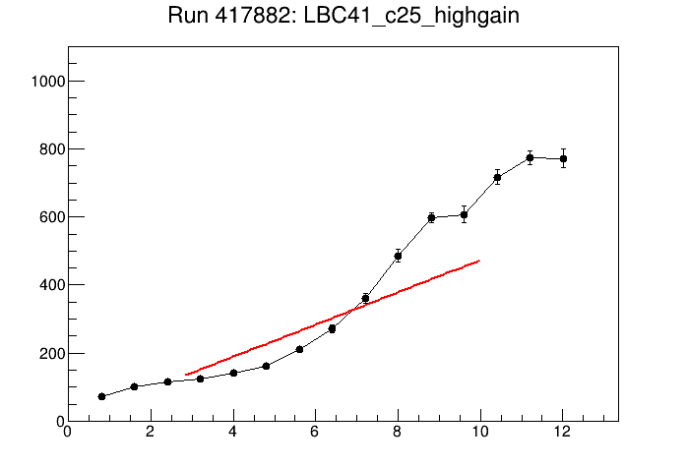
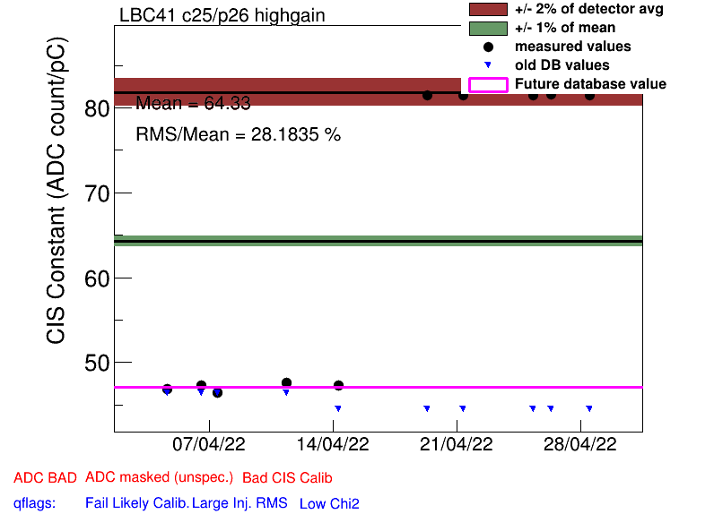
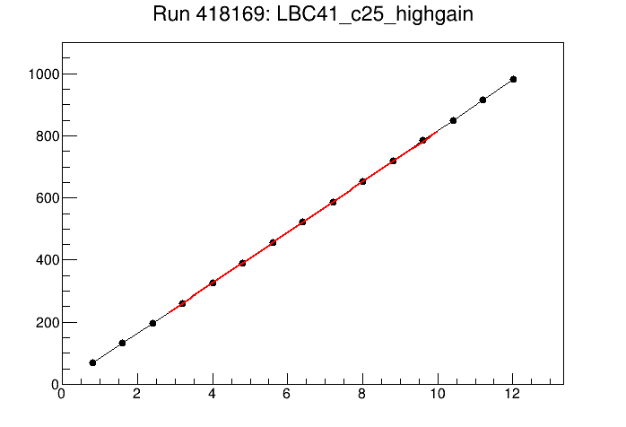
LBC_m41_c25_highgain

Slide 16
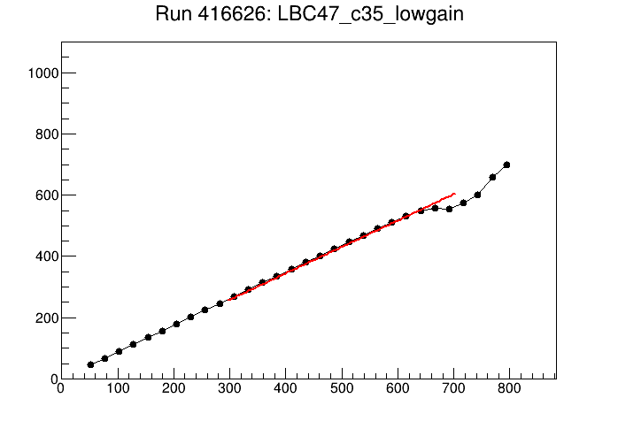
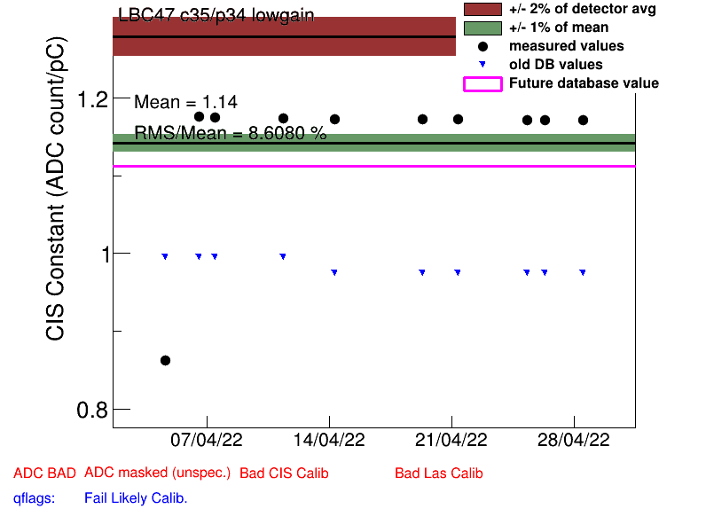
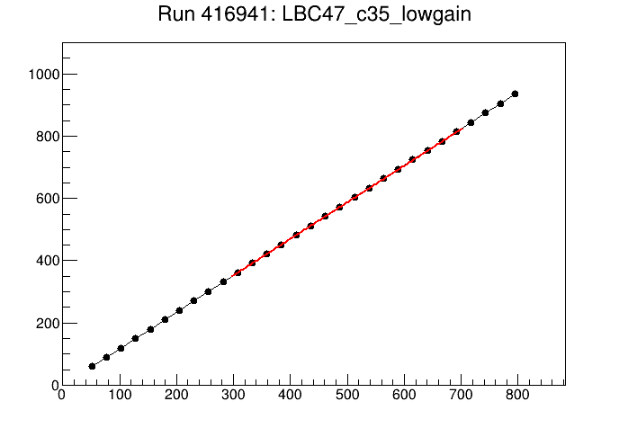
LBC_m47_c35_lowgain

Slide 17
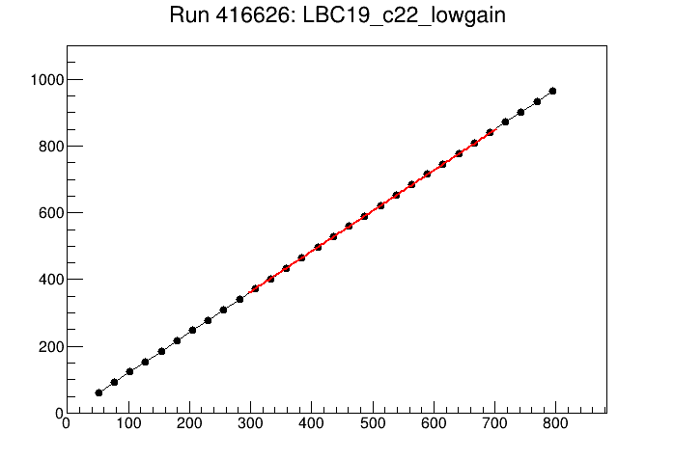
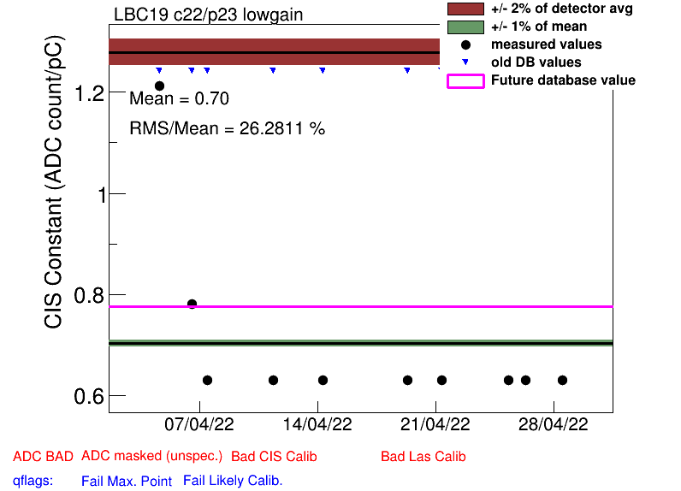
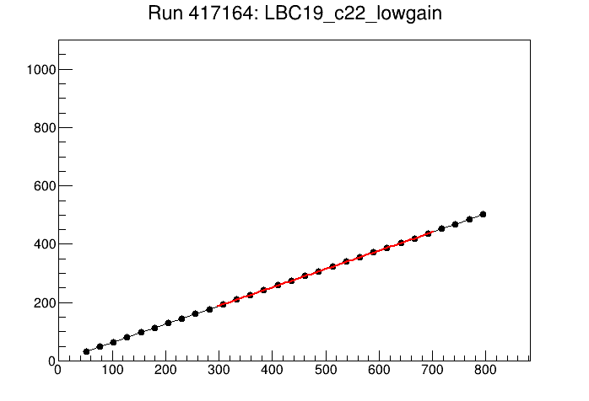
LBC_m19_c22_lowgain

Slide 18
Missing Pulses
I don’t see any missing pulses in CIS scans this month!

Slide 19
